Slide 1
February Member’s Meeting
For your awareness, this call is being recorded

Slide 2
AGENDA
Board Nominations and Vote
Tour of Website
Roundtable Topic: Methods for Tiering Your Vendor Population by Inherent Risk
What Criteria is Used?
Are Factors Other Than Security Considered?
What Tools are Used?
How Often are Ratings Refreshed?
Next Meeting is Thursday, March 28th at 1 PM Central.

Slide 3
BOARD NOMINATIONS & VOTE
Five Board of Director positions available.
Twelve applied.
Bylaws state to qualify they :
need to be a leader of risk and/or governance within their organization,
are an active member in good standing, and
pass an interview process.
A packet of bios for the qualified potential Board of Directors will go out to the membership before the March meeting.
The qualified potential Board of Directors will introduce themselves at the March Member Meeting.
Voting will be available on our website after the March meeting.

Slide 4
TOUR OF TPRA WEBSITE

Slide 5
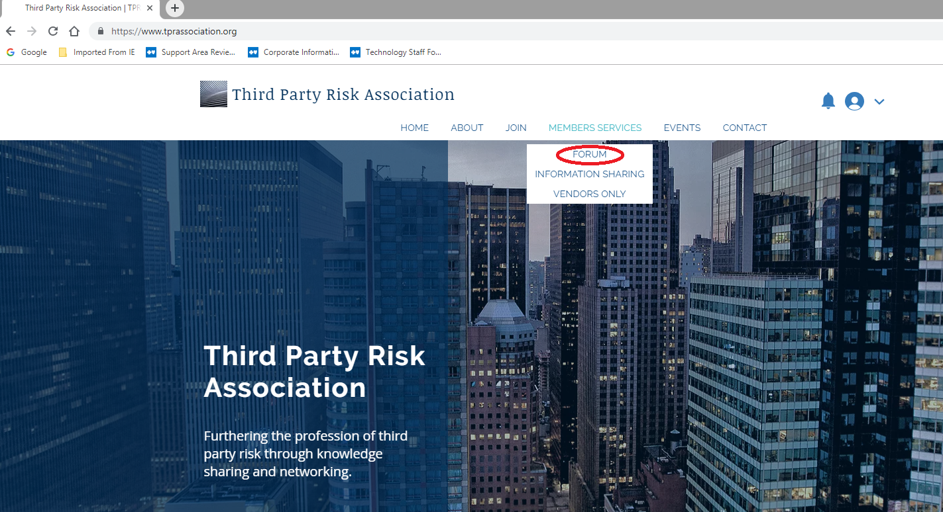

Slide 6
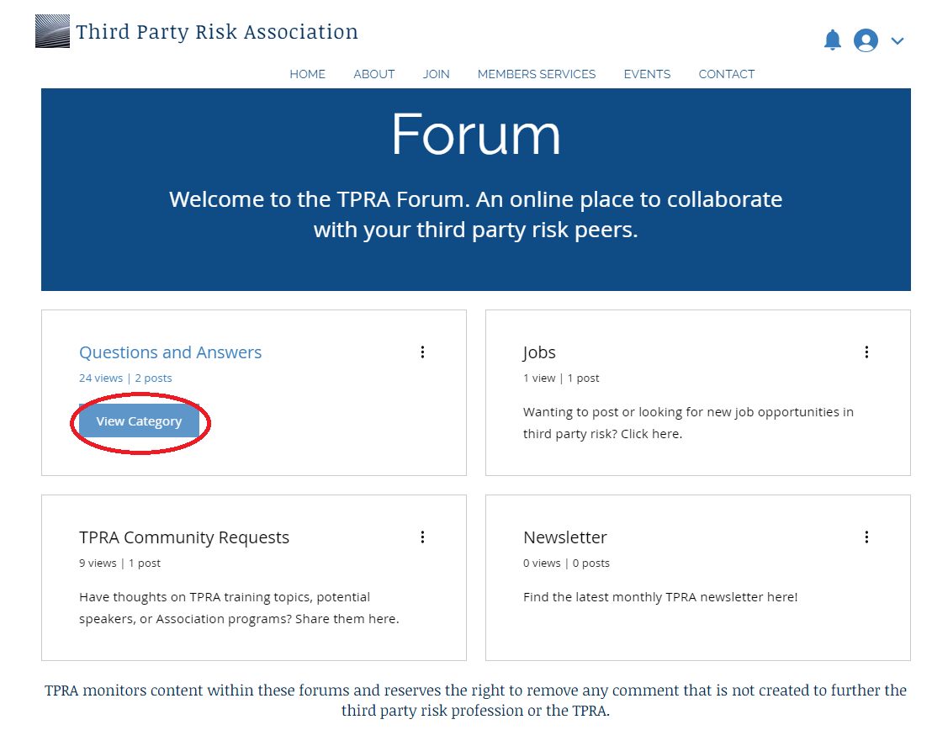

Slide 7
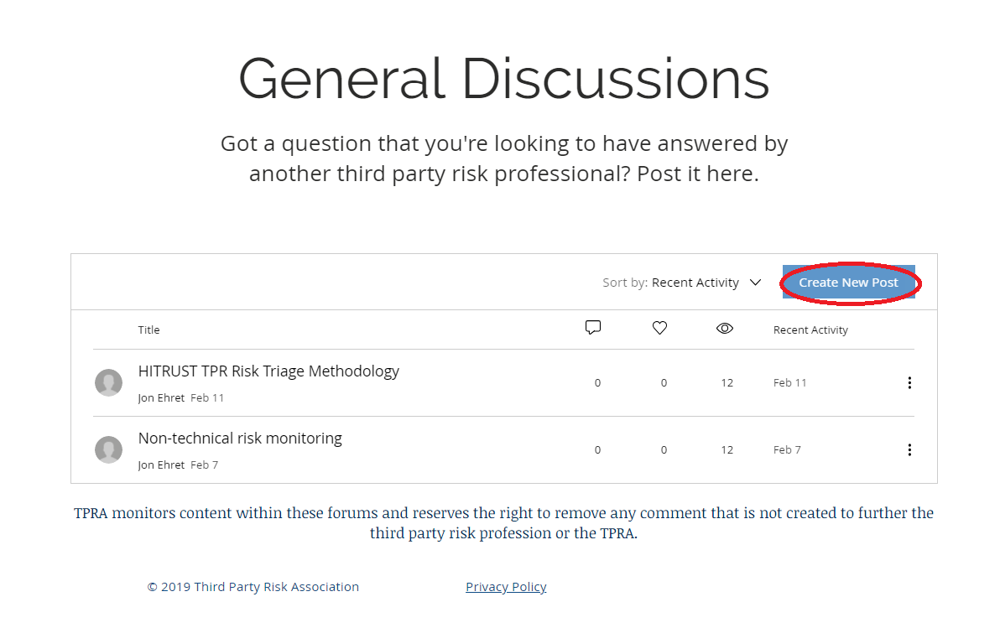

Slide 8
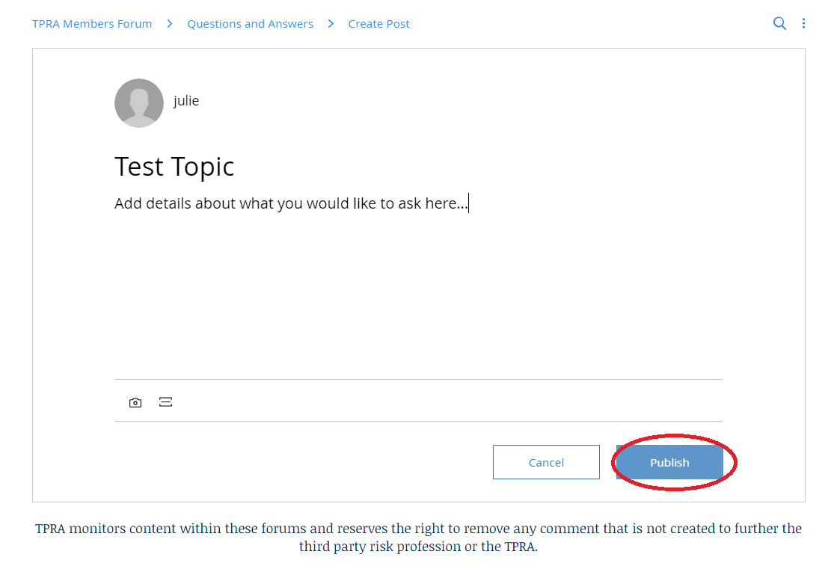

Slide 9
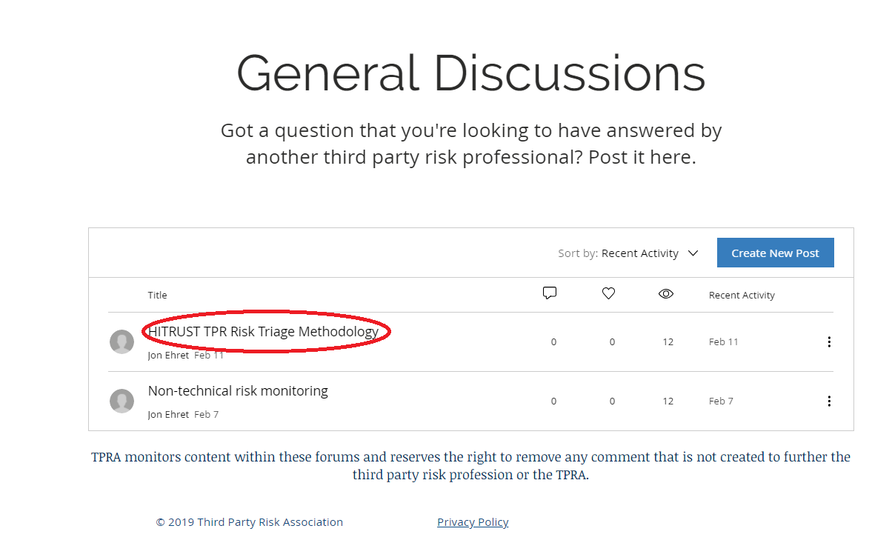

Slide 10
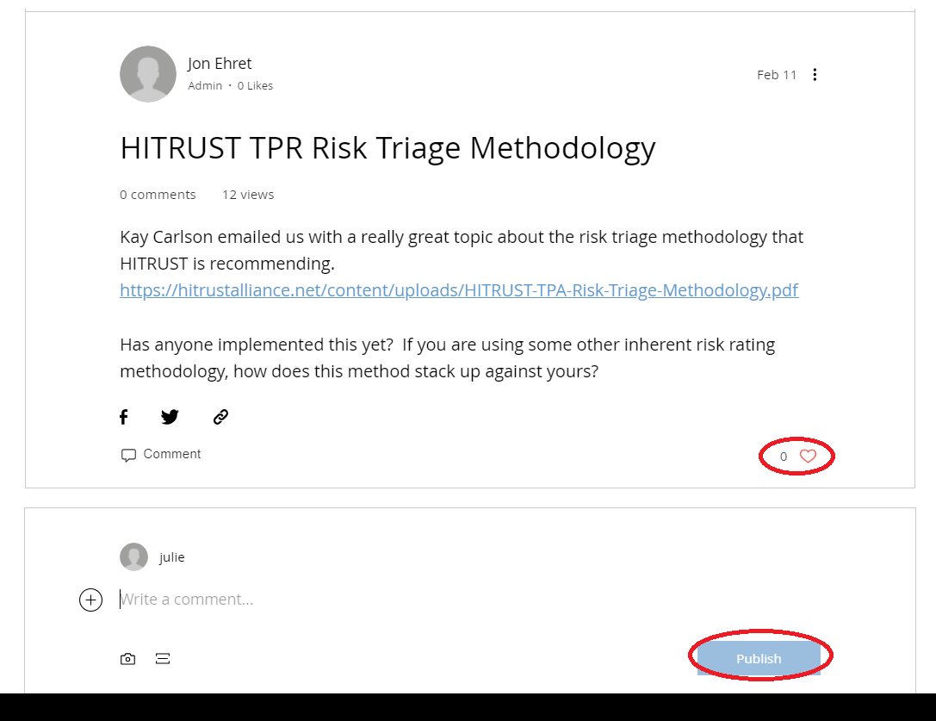

Slide 11
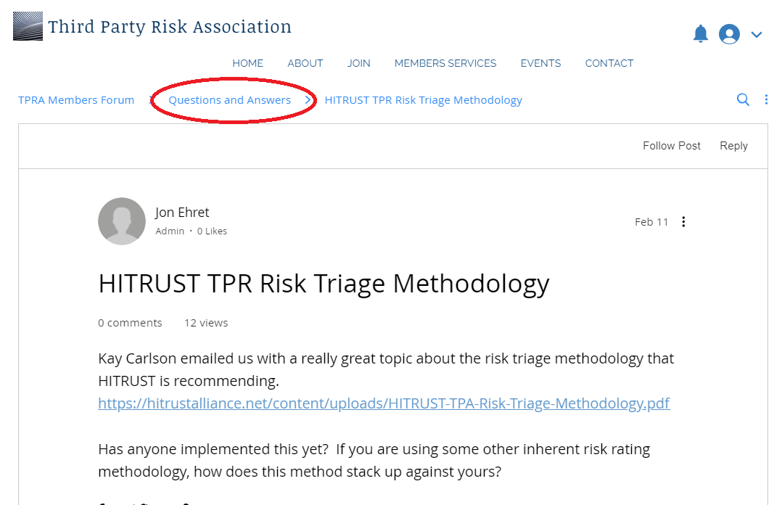

Slide 12
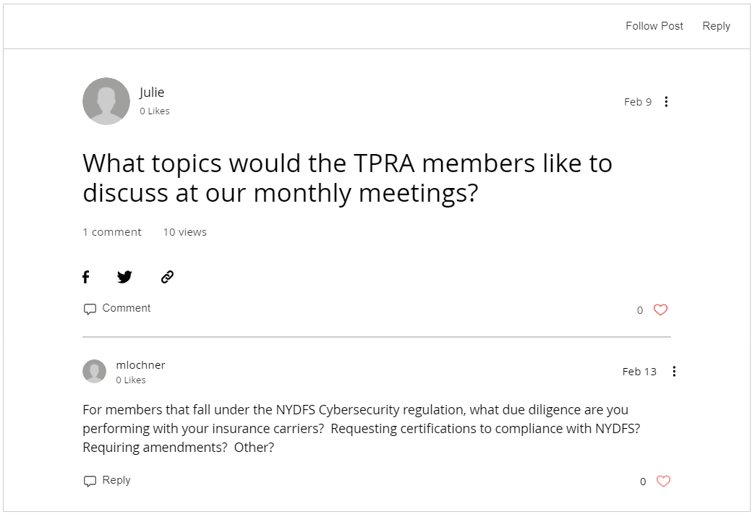

Slide 13
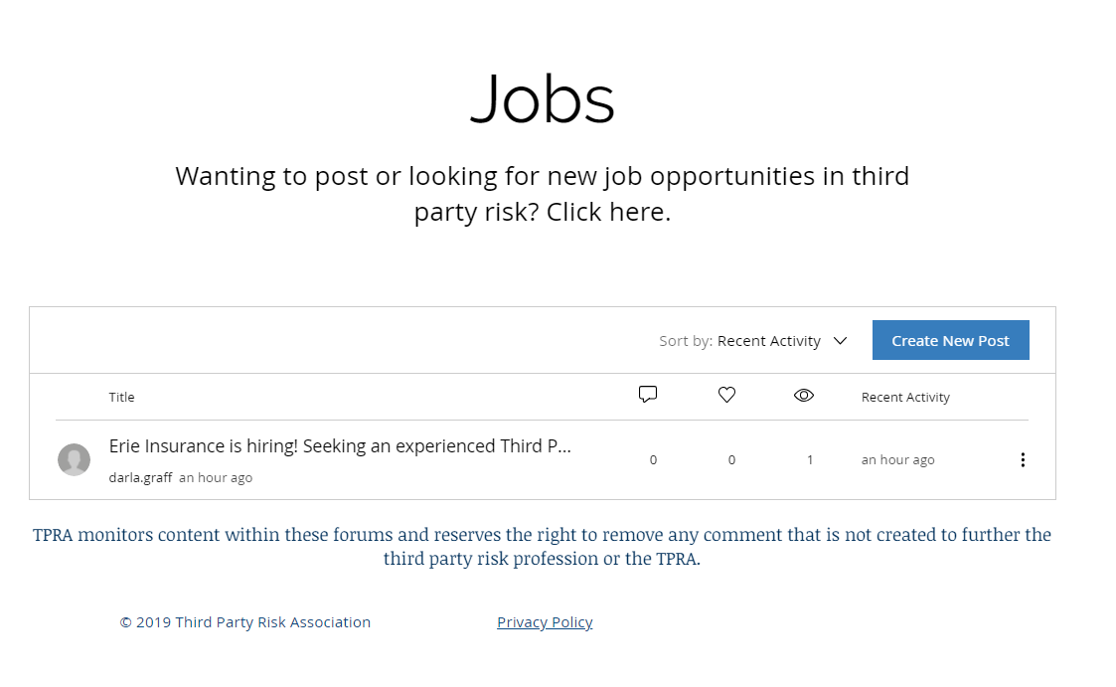

Slide 14
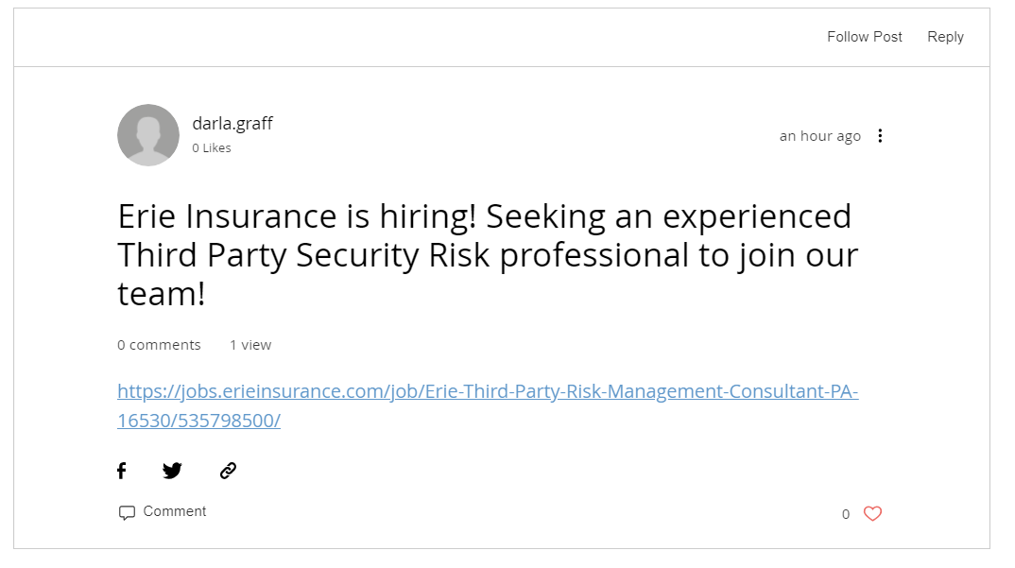

Slide 15
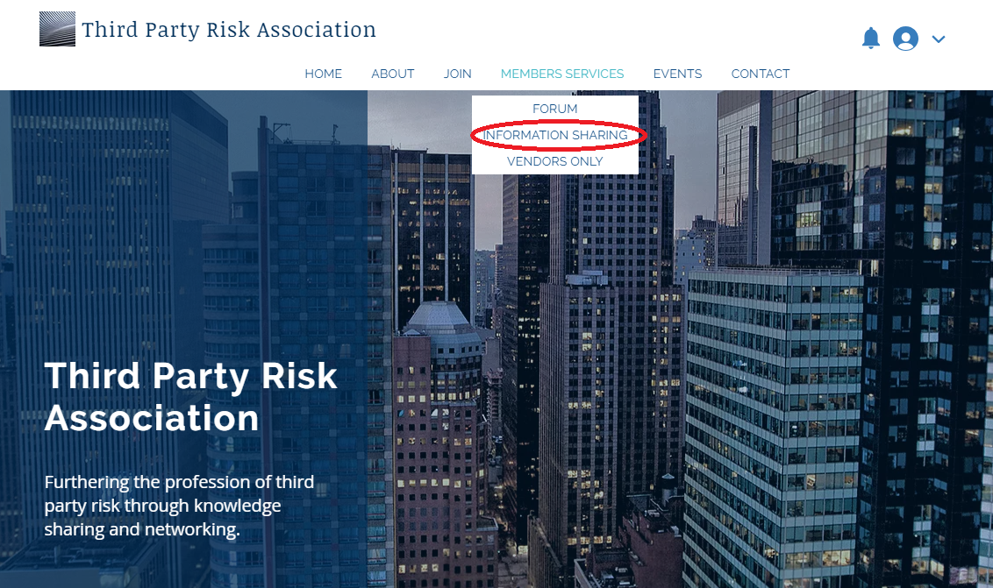

Slide 16
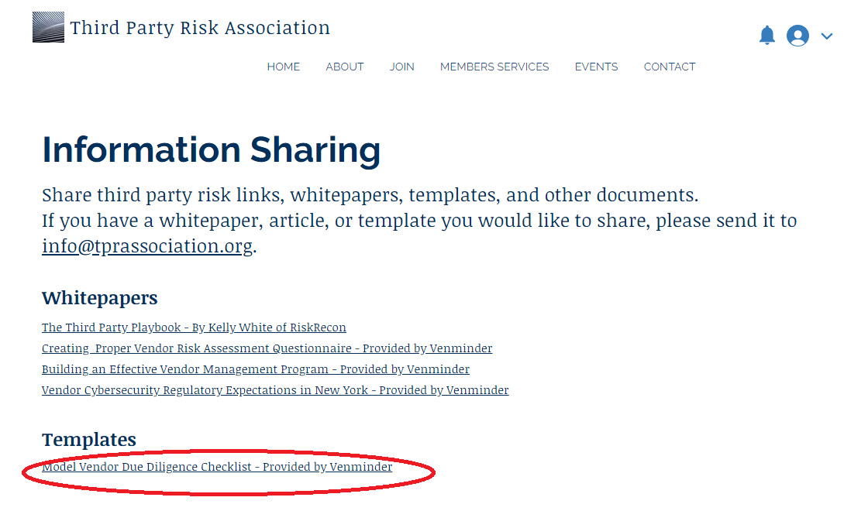

Slide 17
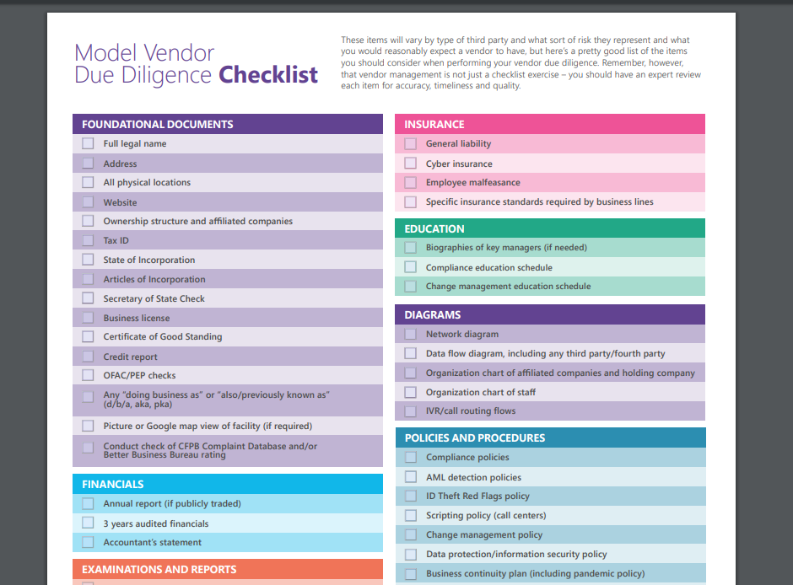

Slide 18
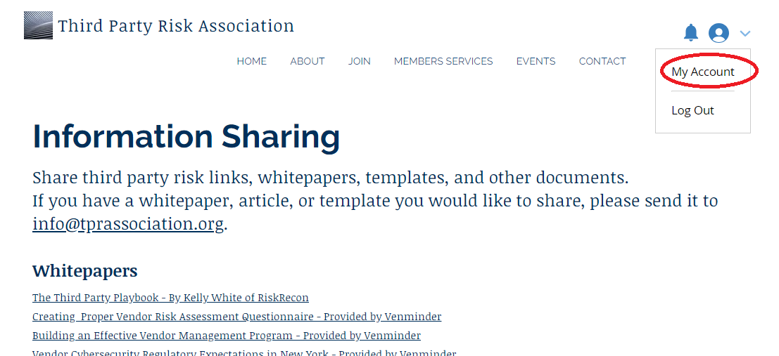

Slide 19
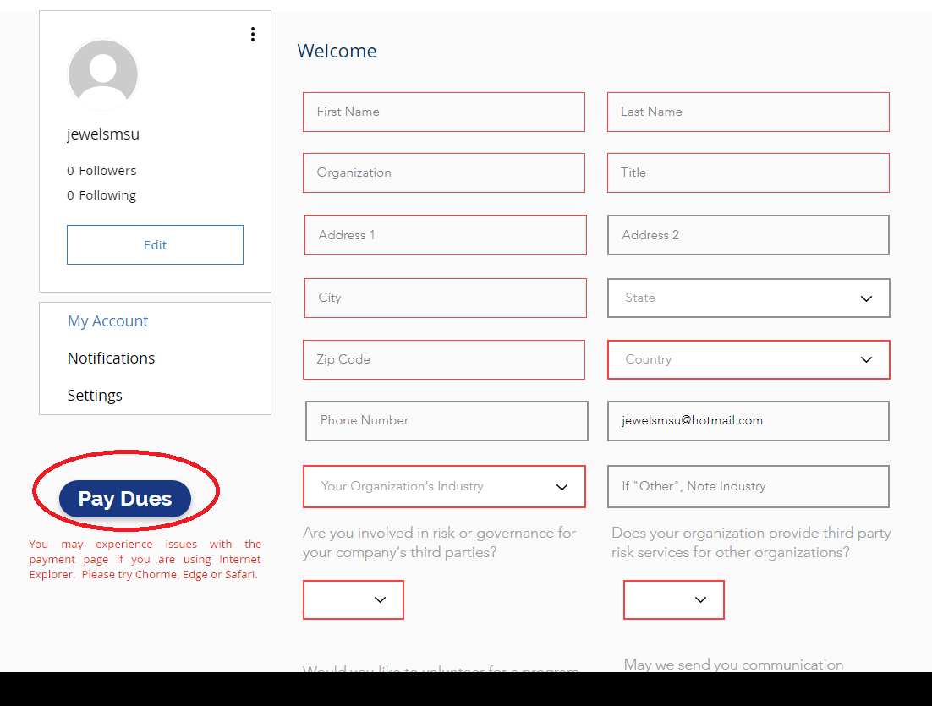

Slide 20
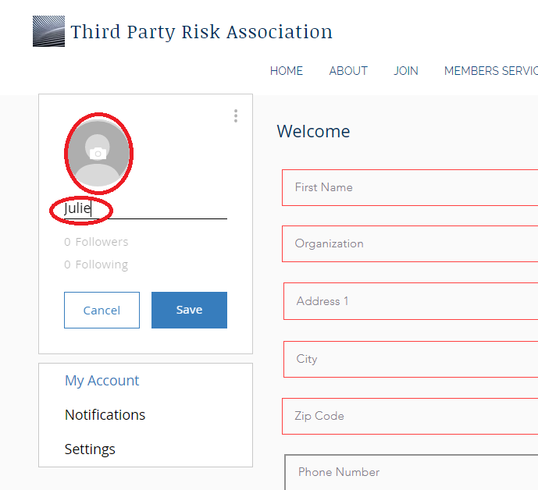

Slide 21
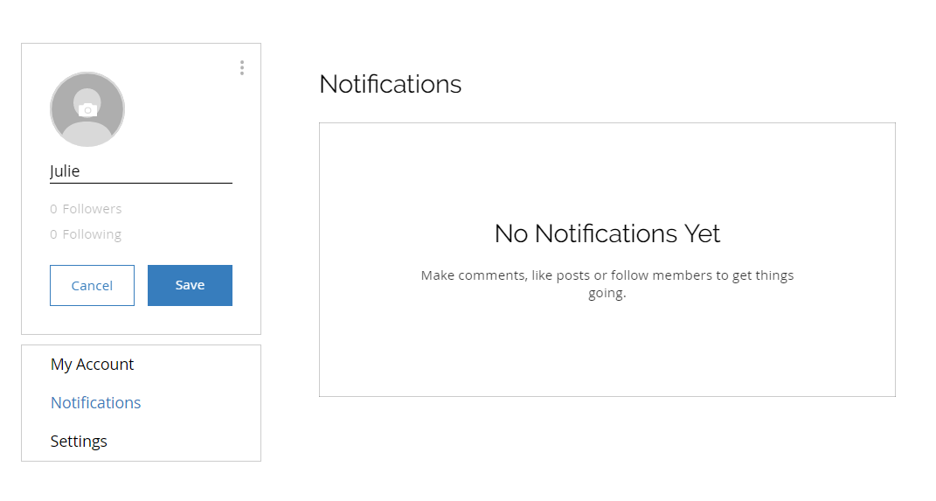

Slide 22
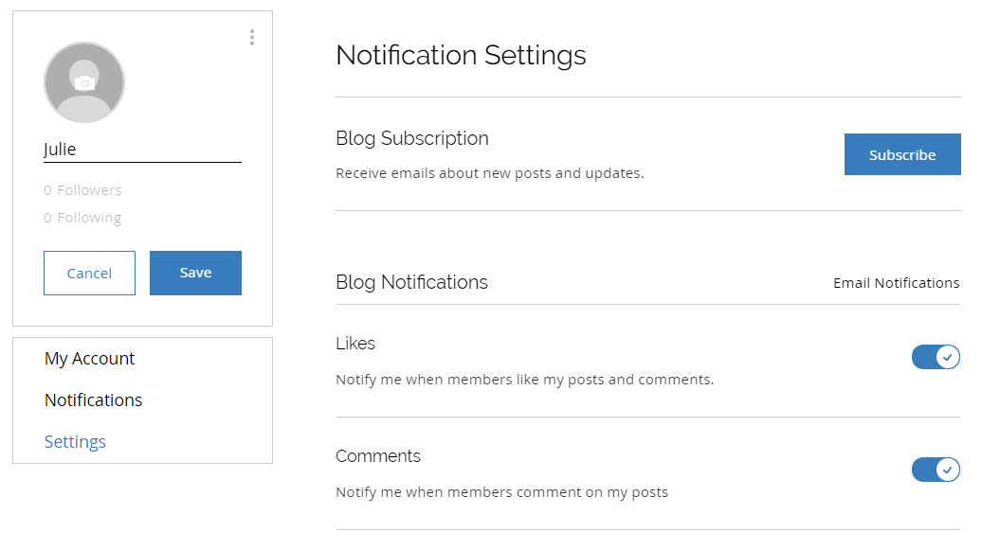

Slide 23
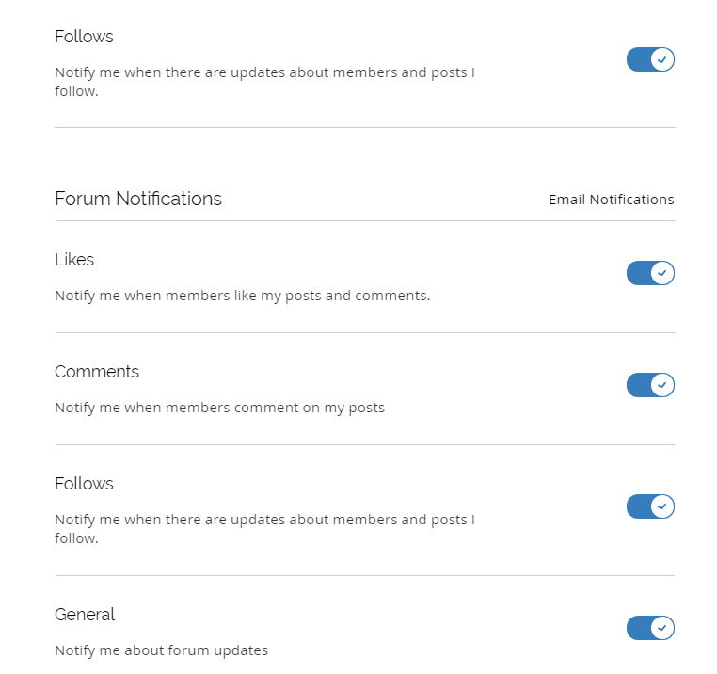

Slide 24
Roundtable Topic: Methods for Tiering Your Vendor Population by Inherent Risk
What Criteria is Used?
Are Factors Other Than Security Considered?
What Tools are Used?
How Often are Ratings Refreshed?

Slide 25
March Member Meeting: Thursday, March 28th at 1 PM Central

